Slide 1

Hair:
DNA &
Collection

Slide 2
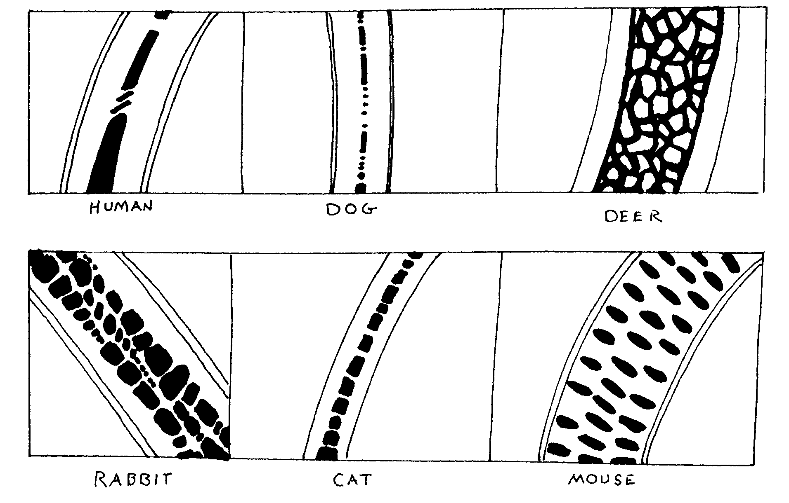
Medulla of Different Species

Slide 3
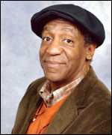
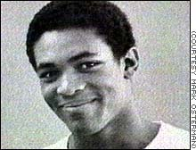
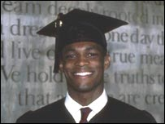
Ennis Cosby
Ennis Cosby, a vacationing graduate student from Columbia University in New York City, was fatally shot January 16, 1997, while changing a flat tire on a dark road near a Los Angeles freeway.

Slide 4

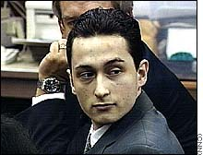
A single human hair, roots intact, that was found in a knit cap wrapped around a .38-cal. revolver connected with the murder. Ballistic tests suggest that the bullet that killed Cosby came from that gun, and DNA testing links the hair to MIKAIL MARKHASEV.

Slide 5
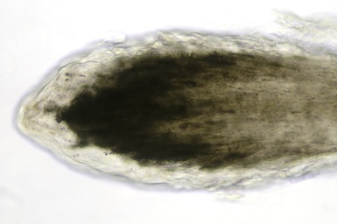
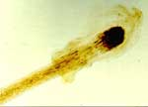
One problem: when the L.A.P.D.'s lab technicians inspected the cap after it was found in March 1997, they found only "shed" hairs without roots; reliable DNA testing requires the root. Nine months later, after it became clear that the case would depend heavily on witnesses with criminal pasts or shaky memories and that physical evidence linking Markhasev to the murder weapon was sorely needed, the cap was checked again. This time, technicians found a single, rooted hair, one that matched the defendant's with a probability of 1 in 15,000.

Slide 6

How can we get nuclear DNA from a hair sample?
A forcibly removed hair from the anagen phase of growth

Slide 7
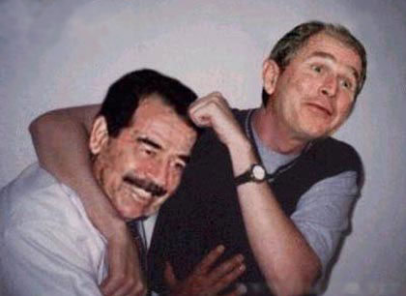
Should we expect to find nuclear DNA from a root at a scene without a violent struggle?
No
Why?
Naturally shed (telogen phase) hairs typically provide an inadequate amount of nuclear DNA

Slide 8
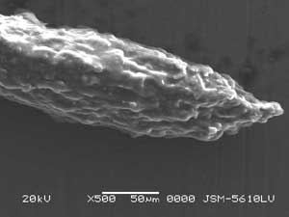
Root: Anagen Phase
Initial growth phase during which hair follicle is actively producing hair, phase may last 6 years, root is flame like in appearance
When pulled this root may contain a follicular tag (rich source of DNA)
Anagen hair root
Root w/ follicular tag

Slide 9
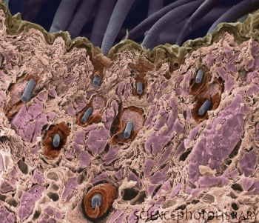
When pulled from the head, many hairs will be found with a follicular tag
Follicular tag-- a translucent piece of tissue surrounding the hair's shaft near the root

Slide 10
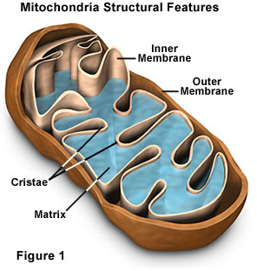
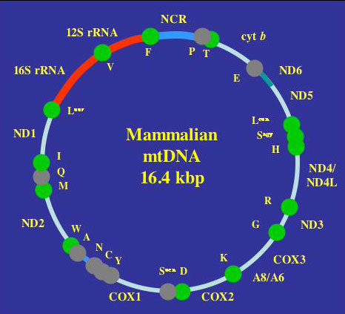
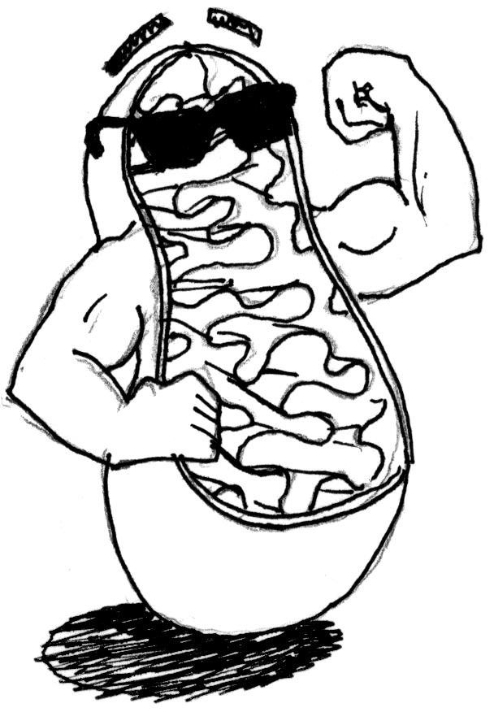
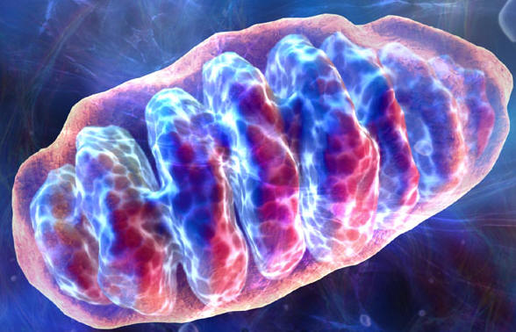
Can the hair shaft itself provide DNA?
Yes!
Mitochondrial DNA

Slide 11
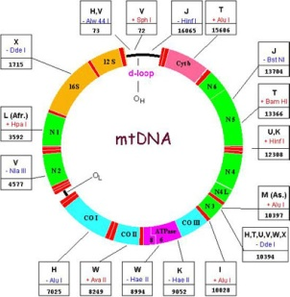
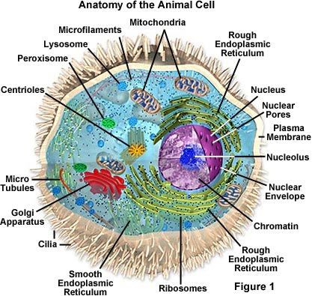
Mitochondrial DNA
Found outside the nucleus
Passed down from mother to child
100s to 1000s of copies of mtDNA in a cell

Slide 12

mtDNA Testing
This process is more difficult and costly than using nuclear DNA.
Less discriminatory
16,000 base pairs vs. 3,000,000,000 nuclear DNA base pairs

Slide 13
In nuclear DNA evidence, the statistical probability of someone other than the accused having the same DNA is extremely small (usually less than one in the population of the world). Whereas, mtDNA probability values are large (the lowest probability is the total size of the current database, i.e. one in 4,839 individuals).

Slide 14
Meet Henry Coffer. He's trying to set a Guinness World Record for the largest hairball. His hairball weighs 167 lbs!
Henry's a barber in Charleston, MO, and he's been collecting hair for quite some time. He started collecting it for a friend who used it in his watermelon patch to ward of coyotes. Well, the friend stopped growing watermelons, but Henry kept collecting hair.

Slide 15
Collection of Hair
Questioned hairs must be accompanied by an adequate number of control samples.
  from victim
  from possible suspects
  from others who may have deposited hair at the scene
Control Sample
  50 full-length hairs from all areas of scalp
  24 full-length pubic hairs

Slide 16
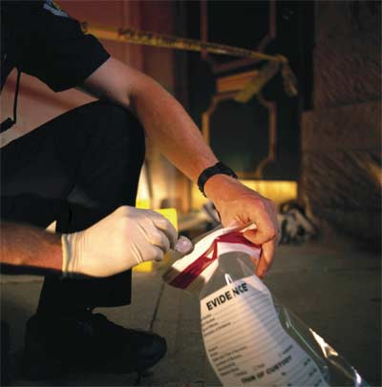
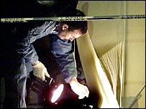
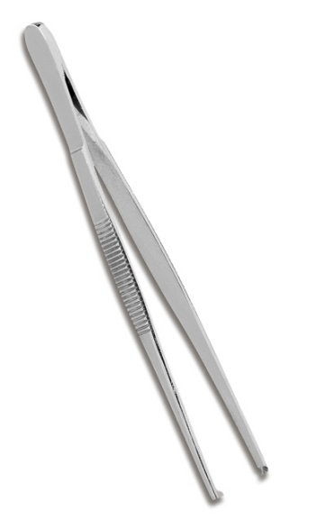
What are some techniques for collecting hair evidence from a scene?
Visually observed-
Hand preferred over tweezers

Slide 17

What are some techniques for collecting hair evidence from a scene?
Clear tape can be used to lift hairs from a variety of surfaces

Slide 18
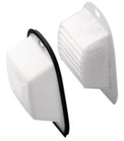
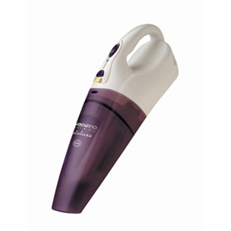
What are some techniques for collecting hair evidence from a scene?
Vacuum method

Slide 19



What are some techniques for collecting hair evidence from a scene?
Shaking in bag

Slide 20


What are some techniques for collecting hair evidence from a scene?
Brushing, scraping, shaking over white paper

Slide 21
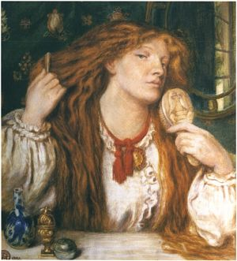
Combing
Rape victim-
Pubic region

